Slide 1
Analyzing Amazon Sales data
Problem Statement:
Sales management has gained importance to meet increasing competition and the need
for improved methods of distribution to reduce cost and to increase profits. Sales
management today is the most important function in a commercial and business
enterprise.
Do ETL : Extract-Transform-Load some Amazon dataset and find for me
Sales-trend -> month wise , year wise , yearly_month wise
Find key metrics and factors and show the meaningful relationships between attributes.
Do your own research and come up with your findings.
Project title | Analyzing Amazon Sales data
technologies | Business Intelligence Domain
Domain | E-commerce
Project Difficulties level | Advanced

Slide 2
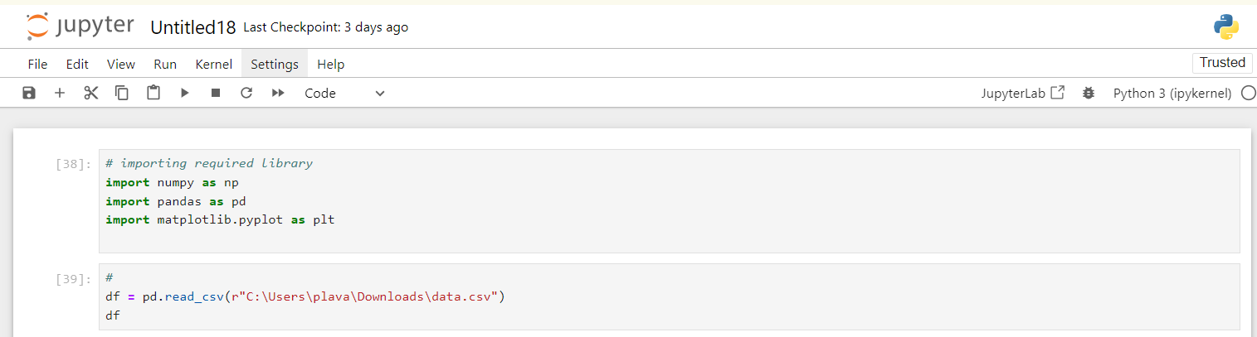
imported the essential libraries for data manipulation and visualization in Python
The code reads a CSV file into a DataFrame, and then displays the DataFrame's content.

Slide 3
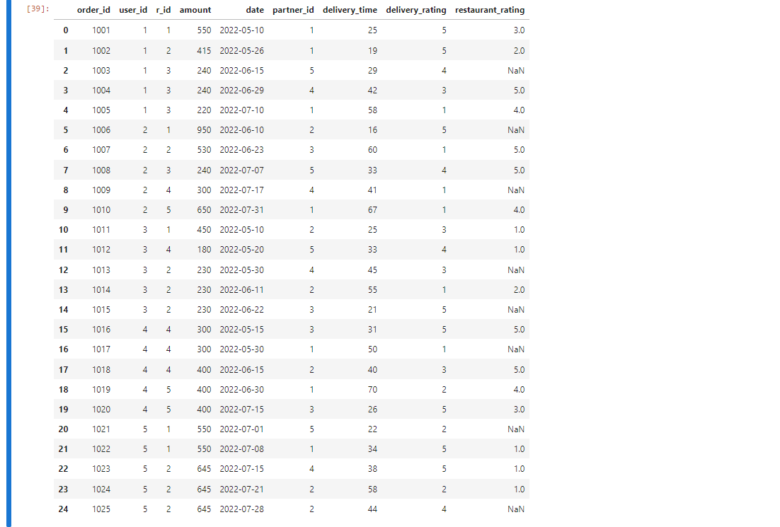

Slide 4
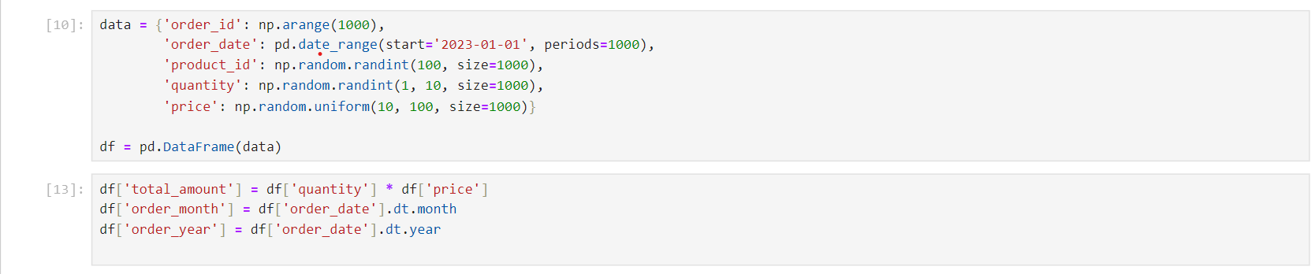
Create a Dictionary:
Creates a dictionary data with keys representing column names and values as lists or NumPy arrays.
order_id: A sequence of numbers from 0 to 999.
order_date: A range of dates starting from '2023-01-01' with 1000 consecutive days.
product_id: 1000 random integers between 0 and 99.
quantity: 1000 random integers between 1 and 9.
price: 1000 random floating-point numbers between 10 and 100.
Create a DataFrame:
Converts the dictionary data into a Pandas DataFrame named df.

Slide 5
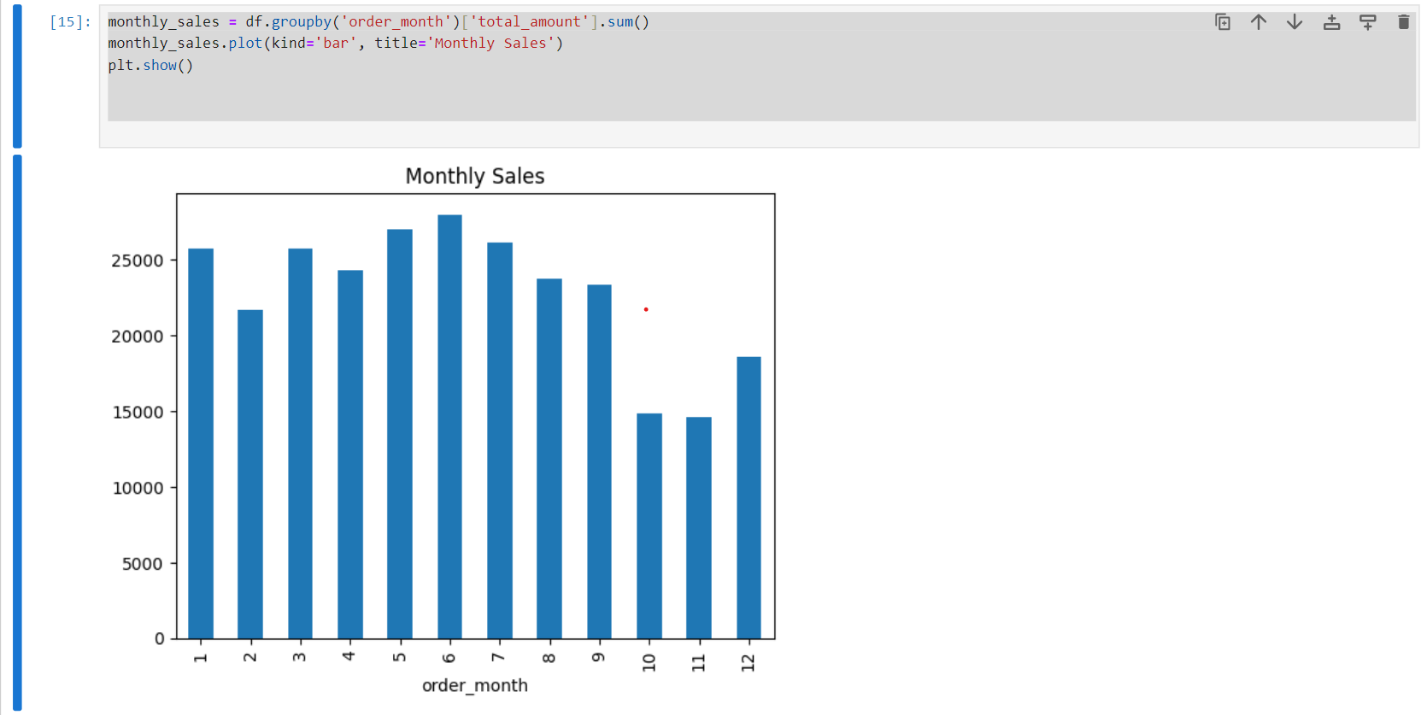
Month-wise: A dataset with a column representing months and corresponding values (e.g., sales, Amount).

Slide 6
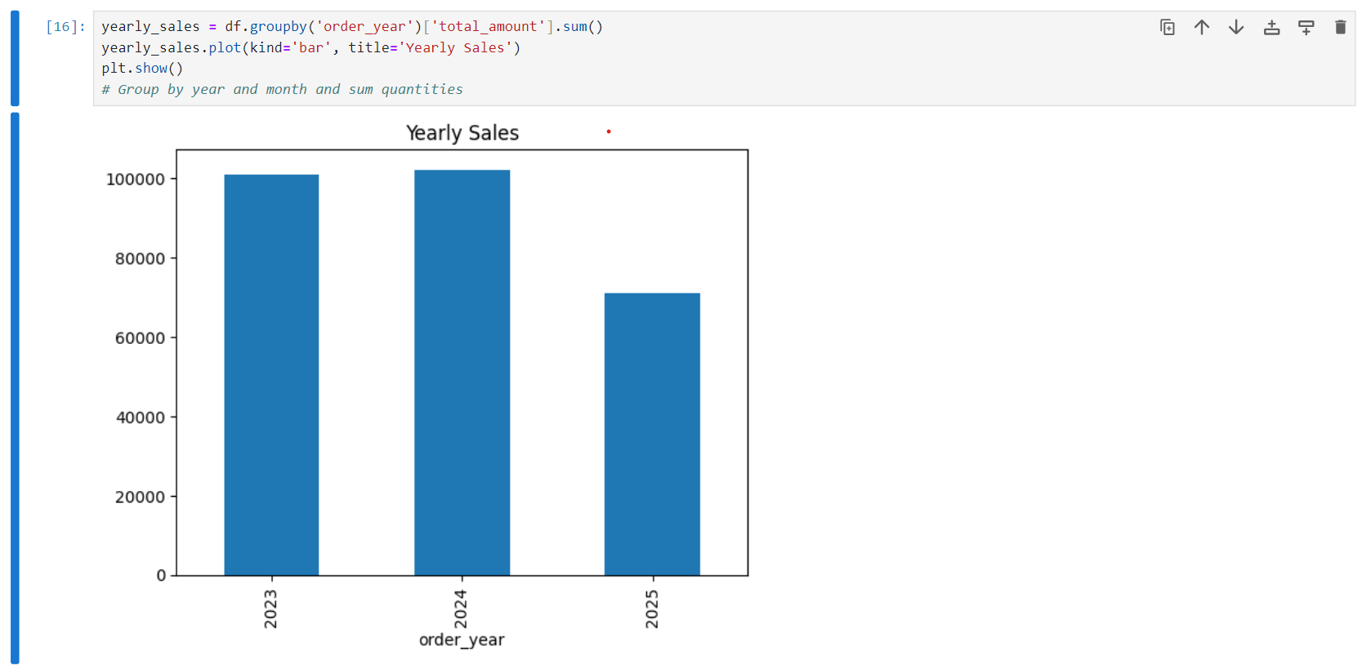
Year-wise: A dataset with a column representing years and corresponding aggregated values.

Slide 7
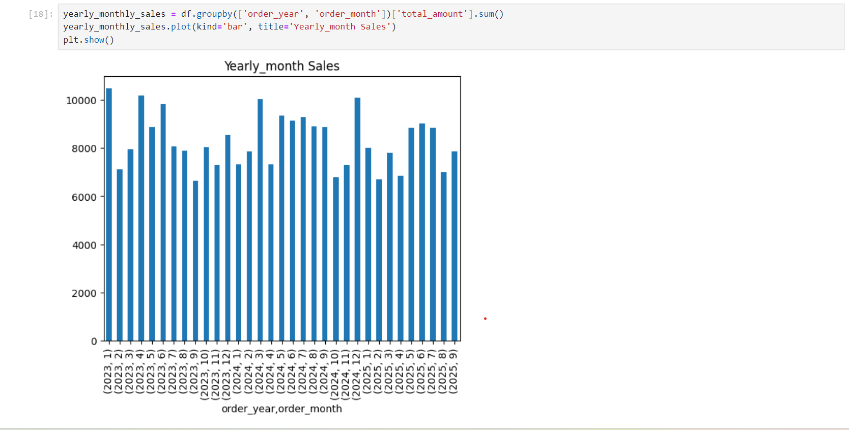
Yearly-month wise: A dataset with columns for both year and month, showing values for each combination.

Slide 8
Finding key metrics and factors and show the meaningful relationships between attributes.
Key Metrics
Based on the provided data (month-wise, year-wise, and yearly-month wise quantities), we can calculate
the following key metrics:
Total Quantity: Overall quantity sold across all periods.
Average Quantity: Average quantity sold per month/year/year-month.
Quantity Growth: Percentage change in quantity compared to the previous period.
Month-over-Month (MoM) Growth: Percentage change in quantity compared to the same month in the previous year.
Year-over-Year (YoY) Growth: Percentage change in quantity compared to the same year in the previous year.
Factors
Potential factors influencing quantity sold could include:
Seasonality: Variations in sales across different months or quarters.
Product Popularity: Differences in sales performance across different products.
External Factors: Economic conditions, competition, marketing campaigns, etc.

Slide 9
Analyzing Relationships Between Attributes
To understand the relationships between these attributes, we can employ the following techniques:
Time Series Analysis
Trend Analysis: Identify long-term patterns in quantity sold over time.
Seasonality Analysis: Detect recurring seasonal fluctuations in sales.
Cycle Analysis: Identify cyclical patterns influenced by economic or other factors.
Irregular Component Analysis: Analyze random variations in sales data.
2. Correlation Analysis
Correlation between Quantity and Time: Calculate correlation coefficients to assess the relationship
between quantity and time periods.
Correlation between Quantity and Other Factors: If additional data is available (e.g., product category, price),
calculate correlations to identify potential relationships.
3. Visualization
Time Series Plots: Visualize the quantity data over time to identify trends and patterns.
Box Plots: Compare quantity distributions across different months or years.
Scatter Plots: Explore relationships between quantity and other variables (if available).

Slide 10
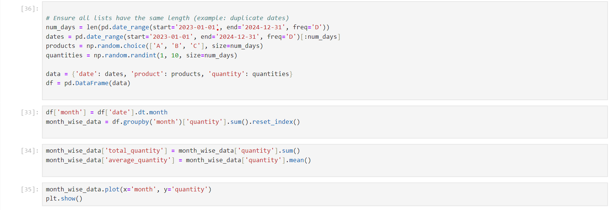

Slide 11
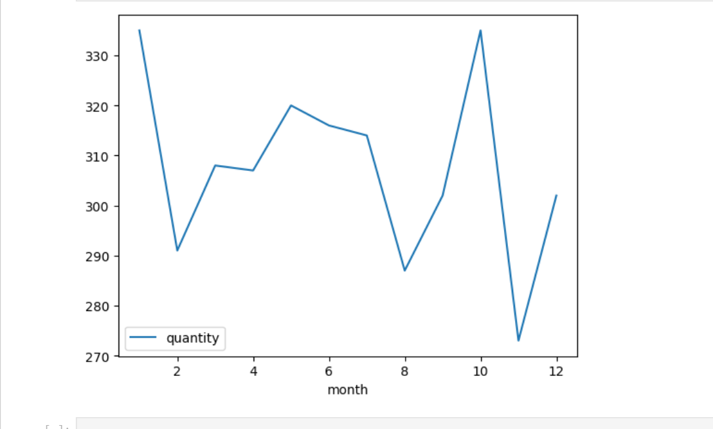

Slide 12
Thank you

